Slide 1
NOAA review of USACE activities in the Greater Atlantic Region
Greater Atlantic Regional Fisheries Office
Peter Johnson, David Bean
Greater Atlantic Regional Fisheries Office
USACE Public outreach meeting
September 23, 2024

Slide 2
OVERVIEW
Endangered Species Act 101
Section 7 Consultation
Required Information and Effects Analysis
USACE – NMFS NLAA Program
Verification Form

Slide 3
Endangered Species Act and Section 7 Consultation Requirements
Section 7(a)(1) requires Federal agencies to:
utilize their authorities in furtherance of the purposes of the Act by carrying out programs for the conservation of species listed pursuant to the Act.
Section 7(a)(2) requires Federal agencies to:
insure that any action it authorizes, funds, or carries out is not likely to jeopardize the continued existence of any listed species or result in the destruction or adverse modification of critical habitat.

Slide 4
ESA Endangered and Threatened Species
Endangered Species - “any species which is in danger of extinction throughout all or a major portion of its range”
Threatened Species - “any species which is likely to become an endangered species within the foreseeable future”
“Species” includes subspecies and Distinct Population Segments (DPSs) of vertebrates when they are: Discrete AND Significant (e.g., Gulf of Maine DPS of Atlantic salmon, Gulf of Maine DPS of Atlantic sturgeon, North Atlantic Right whale)

Slide 5
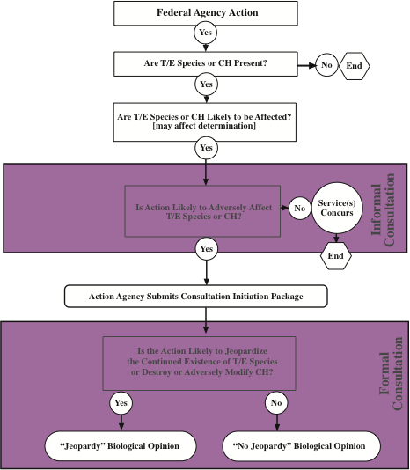
Section 7(a)(2) Process

Slide 6
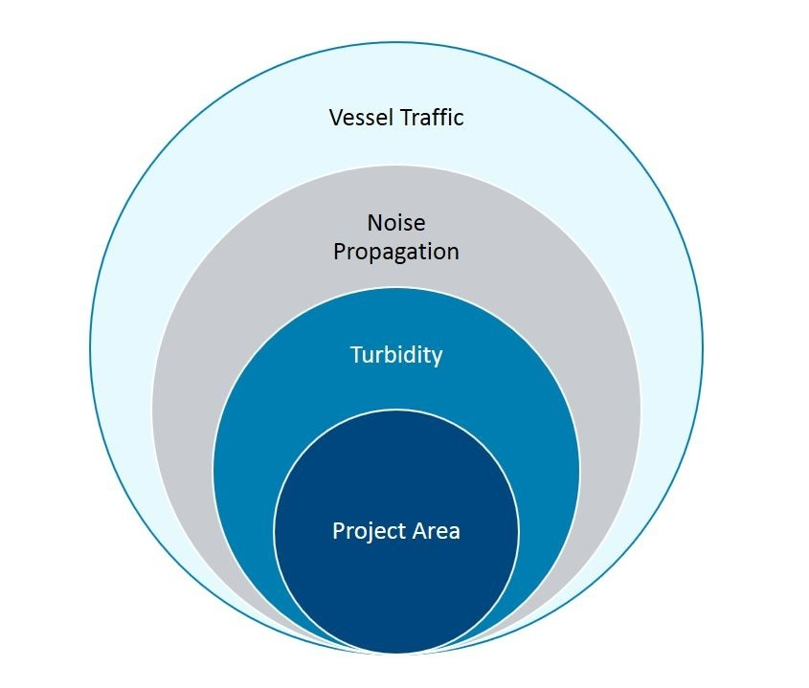
Identify the Action Area

Slide 7
Identify Species Present
GARFO Section 7 Mapper
The species under NMFS jurisdiction and their designated critical habitat that is most commonly encountered for projects in Maine:
Atlantic sturgeon, shortnose sturgeon, Atlantic salmon, several whale species including North Atlantic right whale, sea turtles
Atlantic sturgeon and North Atlantic right whale critical habitats
Use our online interactive Section 7 Mapper to determine what species and critical habitat that may be present:
https://www.fisheries.noaa.gov/new-england-mid-atlantic/consultations/
section-7-species-critical-habitat-information-maps-greater

Slide 8
early consultation/initial screening of projects for “may affect” determinations
USACE projects that are within critical habitat or where ESA species may occur could potentially have three outcomes:
no effect
not likely to adversely affect or;
likely to adversely affect ESA listed species or critical habitat
NOAA can provide “Technical Assistance” to help the agency make the right determinations

Slide 9
Informal consultation: Not Likely to Adversely Affect (NLAA), only if all effects are:
Beneficial = Positive effects, no adverse effects
Discountable = extremely unlikely to occur
Insignificant = impacts are not detectable
Formal consultation: Likely to Adversely Affect;
Proposed action may adversely affect one or more ESA listed species or designated critical habitat
Results in the issuance of a Biological Opinion, which may include an Incidental Take Statement

Slide 10
Formal Consultation Process
Formal consultation is conducted to determine if the action is likely to jeopardize the continued existence of listed species or destroy or adversely modify critical habitat
identify the nature and extent of the effects of the federal action on listed species and critical habitat
if a “no jeopardy” conclusion is reached, provide an exemption for specified levels of “incidental take” otherwise prohibited under section 9 of the ESA through an Incidental Take Statement (ITS)
The ITS includes reasonable and prudent measures determined to be necessary and appropriate to minimize and monitor the impacts of the incidental take to listed species. These measures must be implemented for the take exemption to apply.
identify ways the action agency can help conserve listed species or critical habitat
identify reasonable and prudent alternatives, if any, when an action is likely to result in jeopardy or adverse modification

Slide 11
Information Needs and Effects Analysis
Informal Consultations

Slide 12
Expedited Consultation
USACE
Provides us with all the information needed to evaluate consequences to the species
AND
Effects analysis and effects determination.
NMFS
Provides a one- or two-page letter concurring with the USACE determination

Slide 13
Effects Definition
Effects are all consequences to listed species or critical habitat that are caused by the proposed action, including the consequences of other activities that are caused by the proposed action but that are not part of the action. A consequence is caused by the proposed action if it would not occur but for the proposed action and it is reasonably certain to occur. Effects of the action may occur later in time and may include consequences occurring outside the immediate area involved in the action. (50 CFR 402.02)

Slide 14
Information Needed to be Provided by USACE
Same as for a formal consultation – outlined in the implementing regulations [50 CRF 402.14(c)] for the ESA
The authority under which the agency is proposing the action.
A description of the proposed action
The purpose of the action;
The duration and timing of the action;
The location of the action;
The specific components of the action and how they will be carried out;
Maps, drawings, blueprints, or similar schematics of the action; and
Any other available information related to the nature and scope of the proposed action relevant to its effects on listed species or designated critical habitat.

Slide 15
Information Needed (continued)
A map or description of all areas to be affected directly or indirectly by the Federal action, and not merely the immediate area involved in the action.
Information obtained by or in the possession of the Federal agency and any applicant on the listed species and designated critical habitat in the action area (Presence, abundance, density, or periodic occurrence of listed species and the condition and location of the species' habitat, including any critical habitat.)
A description of the effects of the action.
A summary of any relevant information provided by the applicant, if available.
Any other relevant available information on the effects of the proposed action on listed species or designated critical habitat, including any reports such as environmental impact statements and environmental assessments.

Slide 16
Other Considerations
The applicant should be clearly stated in the beginning of the letter.
Avoidance and minimization measures need to be a part of the proposed project (or condition of the permit) in order to be evaluated in the consultation. Such measures should not be considered in effects analysis If not implemented at all times when species are present or not a condition of the permit.
The location description must include at least county and coordinates (decimal degrees). An address and river mile should also be added if applicable.
When describing the conditions and baseline of the action area, as it is relevant to effects determination, include the whole action area, not only the project area.
In the list or description of species that may be affected by the project, include the listing and recovery plan (if applicable)
(e.g., Atlantic salmon (Salmo salar) (74 FR 29344; Recovery plan: NMFS and USFWS 2019)
Avoid contradicting information or statements in different parts of the document.

Slide 17
Other Considerations (continued)
Do not include effect determinations (i.e. insignificant or discountable, NLAA, LAA) in the species section or any other section than the effects and conclusion sections.
Make sure to provide an “insignificant” or “extremely unlikely to occur” determination when analyzing stressors.
Do not use both, e.g., “we have determined that effects are insignificant and extremely unlikely to occur.” Choose one or the other.
Make sure to use correct determination and language.
Effects (to the species) are too small to be meaningfully measured, detected, or evaluated; therefore, effects are insignificant.
Effects are extremely unlikely to occur.
Include all steps needed from the project description to the effect analysis to make the determination, i.e., do not jump directly from A to C.
The species determination, i.e., not likely to adversely affect (NLAA), comes at the end as a conclusion after all stressors have had been analyzed.
At the end include the sentence “This determination is based on the best available information and commercial data to complete this analysis.”

Slide 18
GARFO (PRD) - USACE (NAD) NLAA Program
Verification Forms

Slide 19
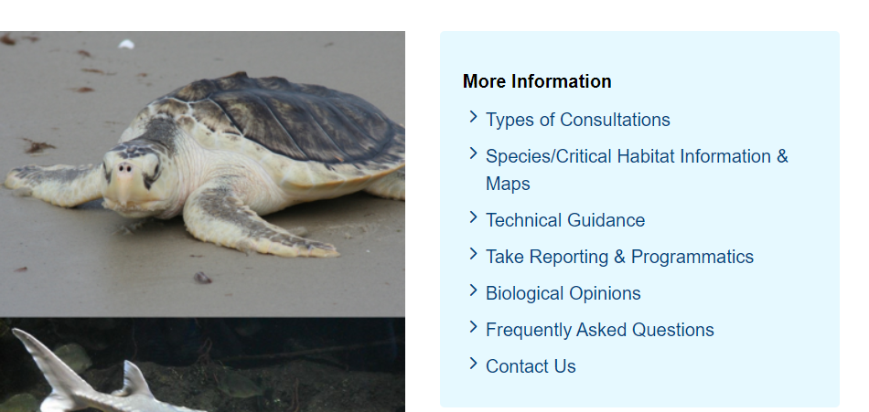
NLAA Program
https://www.fisheries.noaa.gov/new-england-mid-atlantic/consultations/section-7-consultations-greater-atlantic-region

Slide 20
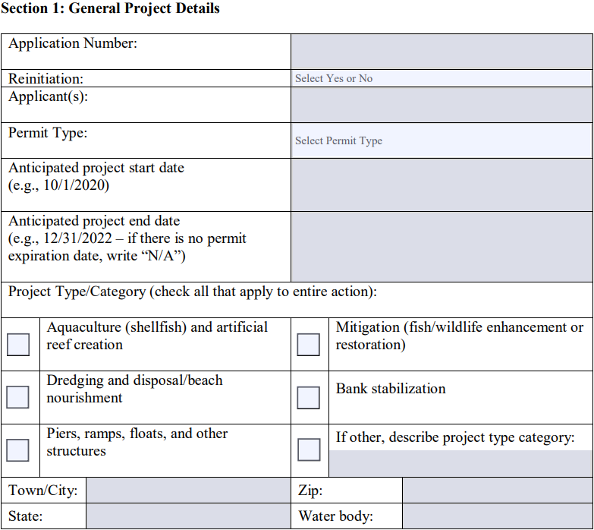

Slide 21
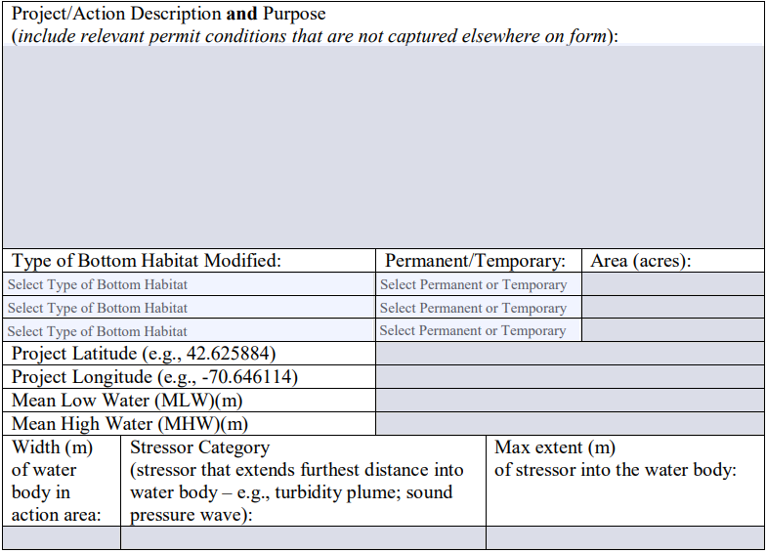

Slide 22
GARFO Section 7 Website
Technical information, information about the consultation process and the NLAA program, species information, and other resources such as a BA template and verification forms can be found on our website:
https://www.fisheries.noaa.gov/new-england-mid-atlantic/consultations/section-7-consultations-greater-atlantic-region

Slide 23
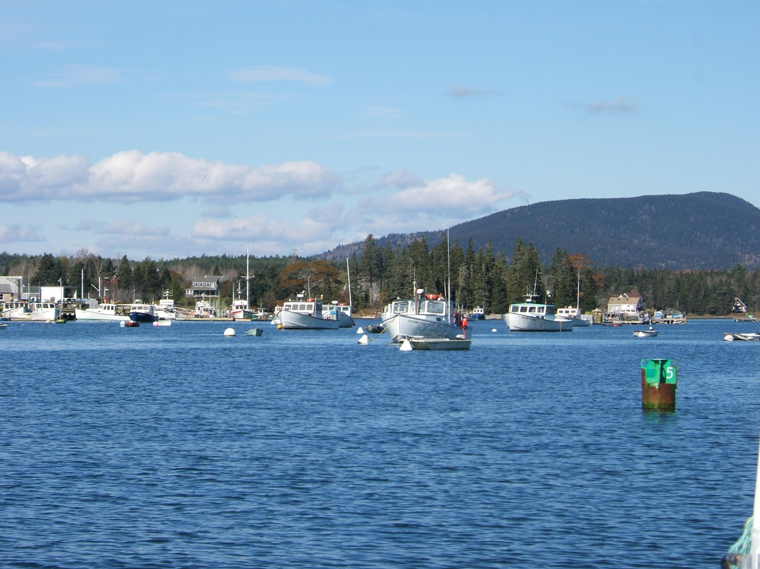
Questions?

